Slide 1
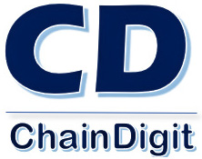
Blockchain for Enterprises
Toronto Meet up
February 15, 2018

Slide 2
Agenda
7.00 to 7.20 : Introduction & Industry Update
Update on the current state Blockchain Technology - Announcements, Releases etc. on Hyperledger, Ethereum Alliance etc.
7.20 to 8.00 : Blockchain for Business - Reality or Hype? By Jimjees Abraham & Tsvetan Georgiev, ChainDigit Inc
Blockchain for Enterprises, Introduction, Permissioned, Enterprise grade Frameworks and B2B Blockchain Applications. Capabilities of Hyperledger Fabric - Current popular framework among Enterprises
8.00 to 8.15 : Meet the Industry Expert : ' Impact of Blockchain on Financing Models’ By Johnny Blackfield, MEng, MMPA, CPA, CA, CBP, CCBP
8.15 to 8.30 : Bring your own Use Case : Open discussion on emerging use cases with expert panel
8.30 to 9.00 : Open discussions and Networking

Slide 3
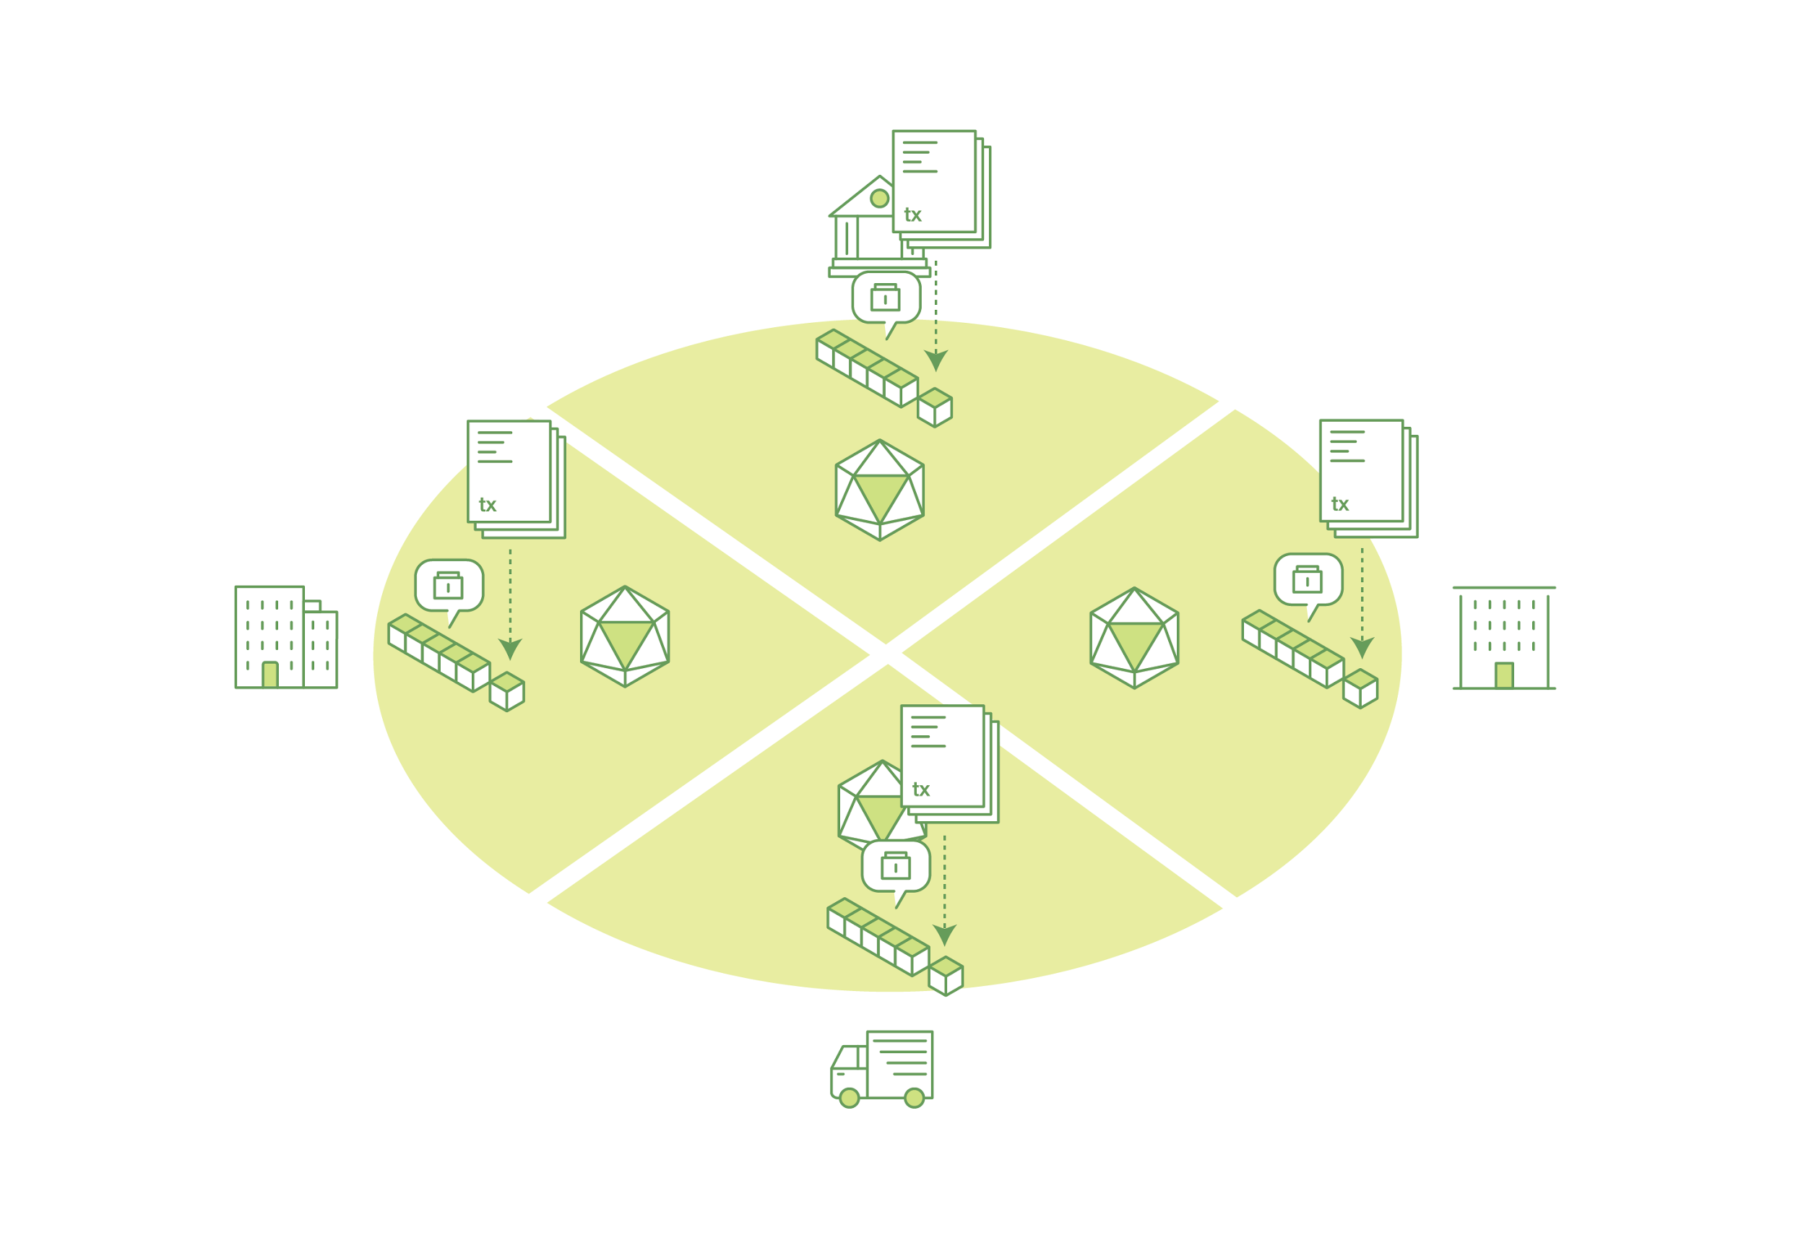
What is a Blockchain?
Distributed Ledger
At the heart of a blockchain network is a distributed ledger that records all the transactions that take place on the network.
In addition to being decentralized and collaborative, the information recorded to a blockchain is append-only, using cryptographic techniques that guarantee that once a transaction has been added to the ledger it cannot be modified

Slide 4
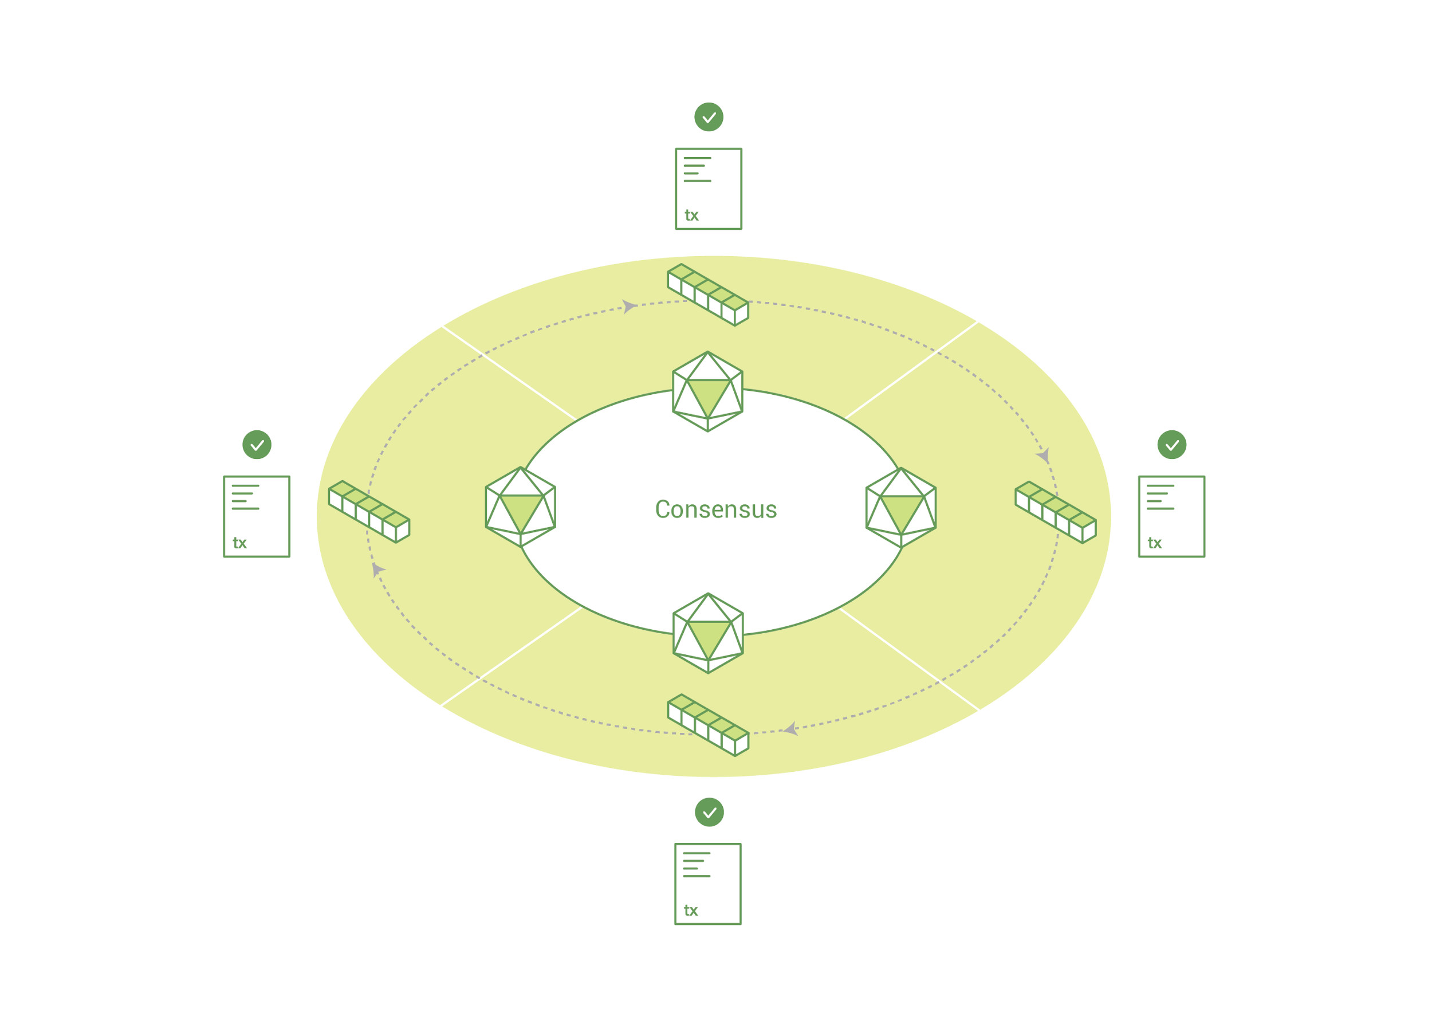
Consensus
The process of keeping the ledger transactions synchronized across the network – to ensure that ledgers only update when transactions are approved by the appropriate participants, and that when ledgers do update, they update with the same transactions in the same order – is called consensus.

Slide 5
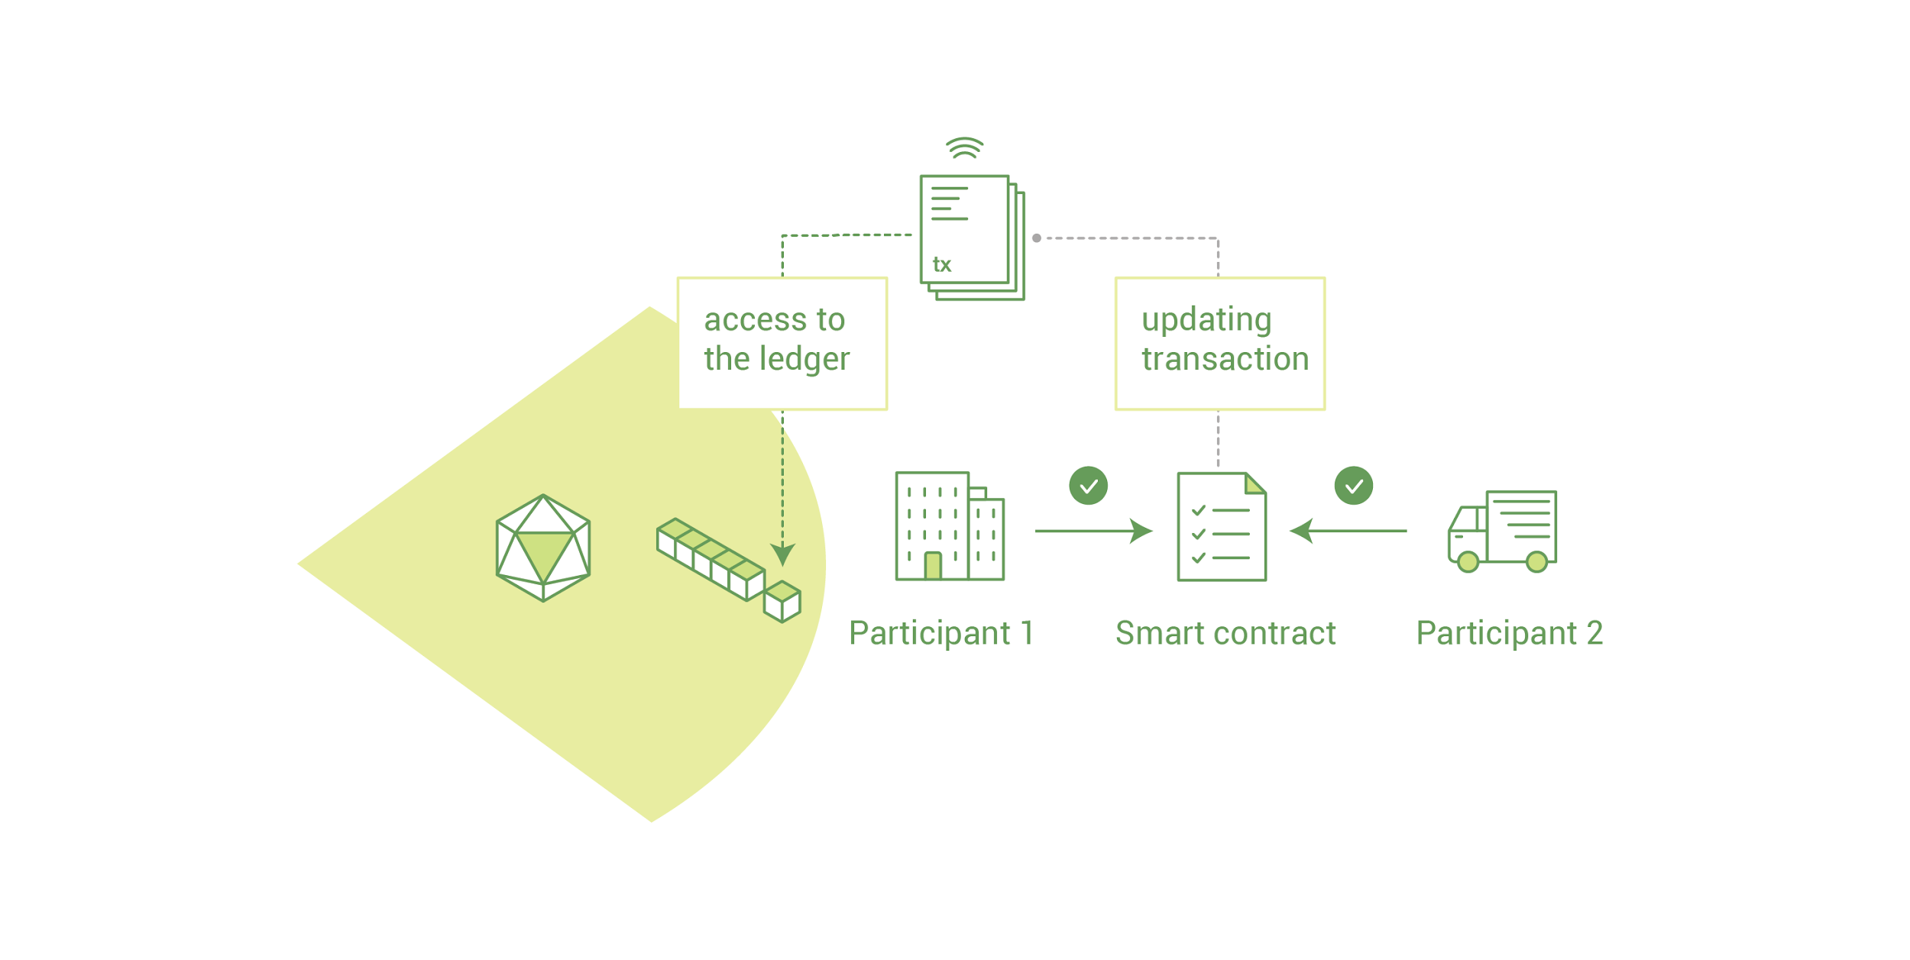
Smart Contracts / Chain code
To support the consistent update of information – and to enable a whole host of ledger functions (transacting, querying, etc) – a blockchain network uses smart contracts / chain code to provide controlled access to the ledger.
Smart contracts are not only a key mechanism for encapsulating information and keeping it simple across the network, they can also be written to allow participants to execute certain aspects of transactions automatically.

Slide 6
Where are we today ?
Good buzz around blockchain due to the popularity of Bitcoin & cryptocurrencies
ICO emerged popular crowdfunding mechanism to raise funds
Two mainstreams of blockchain active – Public & Permissioned / Private.
Awareness of blockchain as a technology – Improving – long way to go
Application development – moving from proof of concepts to production ready
New frameworks emerging frequently.

Slide 7
Recent Updates
Hyperledger update
Hyperledger Fabric Version 1.0.5 is available and is production ready from version 1.0
Release 1.1 planned for March 2018
Hyperledger Sawtooth 1.0 is production ready
Ethereum Update : Ethereum alliance to manage enterprise level – in progress

Slide 8
Types of Blockchain
Permissioned and public block chains
Permissioned block chains
Only authenticated users can participate in writing to the blockchain or perform transactions
Permissioned gives more importance on efficiency and immutability over anonymity and transparency.
Public block chains
Un-permissioned blockchain is a public blockchain where anyone can participate in a transaction
Public blockchain gives highest importance in anonymity, immutability and transparency over efficiency. An example public block chain is Bitcoin.
This leads to why a permissioned blockchain is ideal for enterprises over a public blockchain.

Slide 9
Types of Blockchain
Similarities of Permissioned and public block chains
Both are decentralized peer-to-peer networks, where each participant maintains a replica of a shared append-only ledger of digitally signed transactions.
Both maintain the replicas in sync through a protocol referred to as consensus.
Both provide guarantees on the immutability of the ledger

Slide 10
Need of an Enterprise Blockchain
Data Privacy and confidentiality
Efficiency and speed of transactions
Modular design approach
Hybrid approach
B2B focus
Mining and legal restrictions on location of nodes
Alignment with the vision of going digital
HyperLedger answers all these concerns for enterprise and promises to be a solution for many of its use cases.

Slide 11
Ongoing use cases / Projects
Financial services
Payments – Asset transfer
Ripple
SWIFT
Northern Trust
Retail / Supply chain
Walmart
Healthcare
Change Health Care
Insurance
AIG

Slide 12
Key use cases - Financial services & Government
Payments – Asset transfer
KYC
Clearing and settlement
Digital Identity management
Trading platforms
Trade finance
Regulatory Compliance and Audit
Insurance
Peer to peer lending
Taxation - Government
Record keeping

Slide 13
Key use cases - Retail and Consumer goods
Preventing fraud in a supply chain
Tracking and visibility across the chain
Provenance for high value goods
Managing claims, returns, warranty services
Potential integration with smart devices & sensors
Preventing identity fraud
Loyalty management
Same source of truth for all
Easy audits and dispute management
Potential integration with regulatory bodies for cross border movements
Notes:
Key Value drivers
Prevention of counterfeit goods
Reduces cost of operations for audits, tracking of goods, claims processing etc.
Better customer satisfaction & trust - due to verifiable authenticity of goods
Faster and reliable cross-border goods movement

Slide 14
Key use cases - Pharma & Healthcare
Patient master record management
Smart prescriptions and pharmacy
Drug supply chain and provenance
Health care and insurance - Claims adjudication and billing management

Slide 15
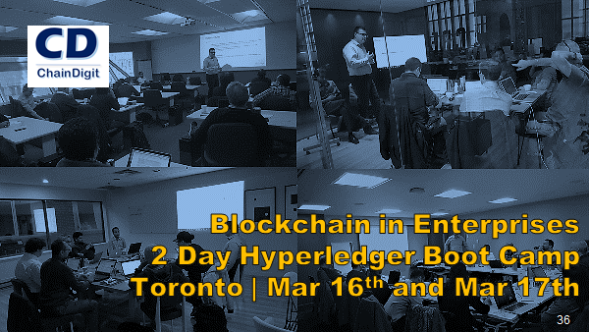
www.chaindigit.com/trainings

Slide 16

Blockchain project started by Linux foundation
The objective of the project is to advance cross-industry collaboration by developing blockchains and distributed ledgers, with a particular focus on improving the performance and reliability of these systems – mainly targeted for business networks
Integration capabilities with independent open protocols and standards by means of a framework for use-specific modules, including blockchains with their own consensus and storage routines, as well as services for identity, access control and smart contracts.

Slide 17






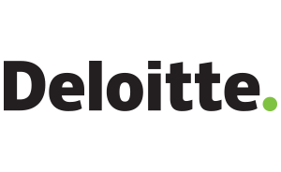











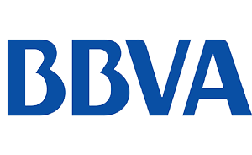
Hyperledger Members - to name a few

Slide 18
Hyperledger Blockchain Frameworks
Fabric
Intended as a foundation for developing applications or solutions with a modular architecture, Hyperledger Fabric allows components, such as consensus and membership services, to be plug-and-play.
Sawtooth
Modular platform for building, deploying, and running distributed ledgers.
Includes a novel consensus algorithm, Proof of Elapsed Time (PoET), which targets large distributed validator populations with minimal resource consumption.
Burrow
Permissionable smart contract machine. Burrow provides a modular blockchain client with a permissioned smart contract interpreter built in part to the specification of the Ethereum Virtual Machine (EVM).
Iroha
Hyperledger Iroha is a business blockchain framework designed to be simple and easy to incorporate into infrastructural projects requiring distributed ledger technology.

Slide 19
Hyperledger Fabric 1.0 capabilities
Hyperledger Fabric is a unique implementation of distributed ledger technology (DLT) that delivers enterprise-ready network security, scalability, confidentiality and performance, in a modular blockchain architecture. Hyperledger Fabric delivers the following blockchain network capabilities:
Identity management
Privacy and confidentiality
Efficient processing
Chaincode functionality
Modular design

Slide 20
Blockchain use case evaluation
Typical question we hear / ask / evaluate for identifying whether blockchain makes sense :
Do you have a process which takes longer where the trust of data is an issue?
Are you managing contractual relationships between customers or in your ecosystem?
Do you have a process where all the parties involved would agree faster if all have the same information - without the need for an manual audit against each other ?
Do you have processes where new parties gets added or removed in the value chain ?
Do you have process or systems - internal , external or both , where you face issues in integration?
Do you have processes which takes long for data reconciliation due to different systems, architecture ?
Why blockchain ? Can it be enabled without blockchain?

Slide 21
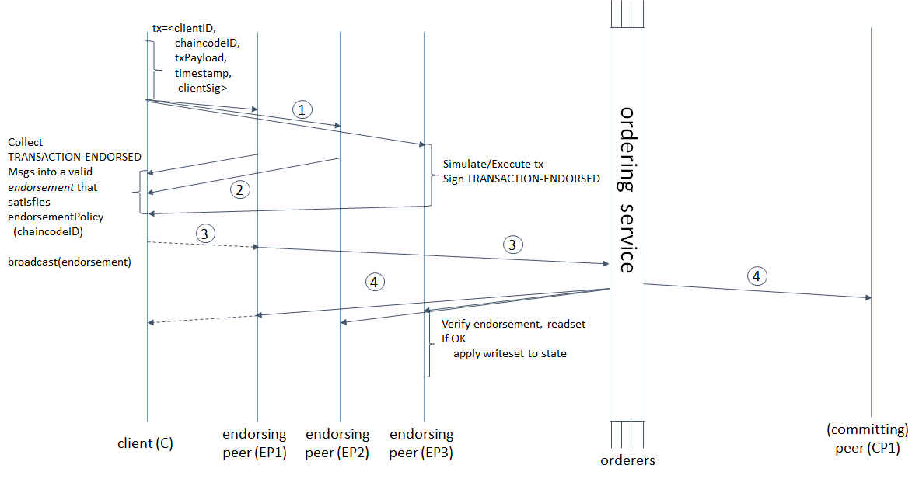
Transaction Flow

Slide 22
Hyperledger Fabric 1.1 – upcoming
Node JS chaincode
NodeJS connection profile
Chaincode level encryption library
Encrypt sensitive data on chaincode level
Chaincode Attribute Based Access Control (ABAC)
Enforce chaincode based access control through certificate based attributes (i.e. roles)
Chaincode APIs to retrieve transaction submitter information including certificate attributes

Slide 23
Hyperledger Fabric 1.1 – upcoming
Performance improvements
Orderer – horizontal scaling and performance
Parallel transaction validation
Private Channel Data
Keep data local to set of peers through policies
Private data will not be send as part of the transaction
Java chaincode
Fine grained access control on a channel
Identity based access control on invoke chaincode, retrieve blocks, etc.
Types of MSP identities to fine grain access policies
Peer, client, orderer

Slide 24
Potential deployment models
Cloud hosted on one network
All the peers are running in one network - any cloud platform of choice, but all the peers agree to connect to the same network
Cloud hosted multiple networks
Different organizations within the network deciding on different cloud networks to run their nodes
Participant hosted intranet​
On-premise network owned and managed by the organization
Hybrid approach
Part of the network on cloud and some peers to be on-premise

Slide 25
ChainDigit
Who are we ?
Boutique Hyperledger consulting organisation for Enterprises initiated in 2016.
Led by senior IT leaders with hands on experience on large enterprise systems
Strategists with experience in enterprise wide digital transformations with a clear focus on Blockchain Applications for Enterprises
ChainDigit proprietary IP for Blockchain accelerators
Partnered with global blockchain leaders
Hyperledger development community of very motivated senior and junior developers in Canada & India
ChainDigit can be your partner to enable your blockchain initiatives with a range of services which can ease adoption and deployment.
ChainDigit fills the demand for a comprehensive Service Provider in this space for consulting, training and development.

Slide 26
How can we help? Blockchain Services for Enterprises
Consulting
Training
ACCELERATORS
Provisioning
Application Services
ChainDigit can be your partner to enable your blockchain initiatives with a range of services which can ease adoption and deployment.
ChainDigit fills the demand for a comprehensive Service Provider in this space for consulting, training and development.

Slide 27
Thank You!
www.chaindigit.com

